Slide 1

Remote Controlled Car with Handmade Electric Motor
Tuna Çelebi S028940
Seyit Kubilay Uluçay S029261

Slide 2
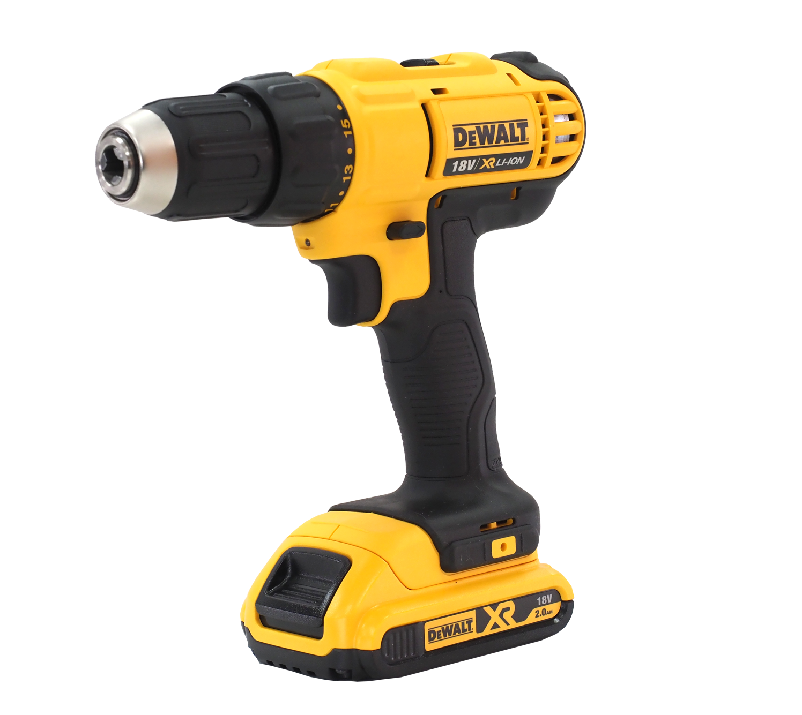
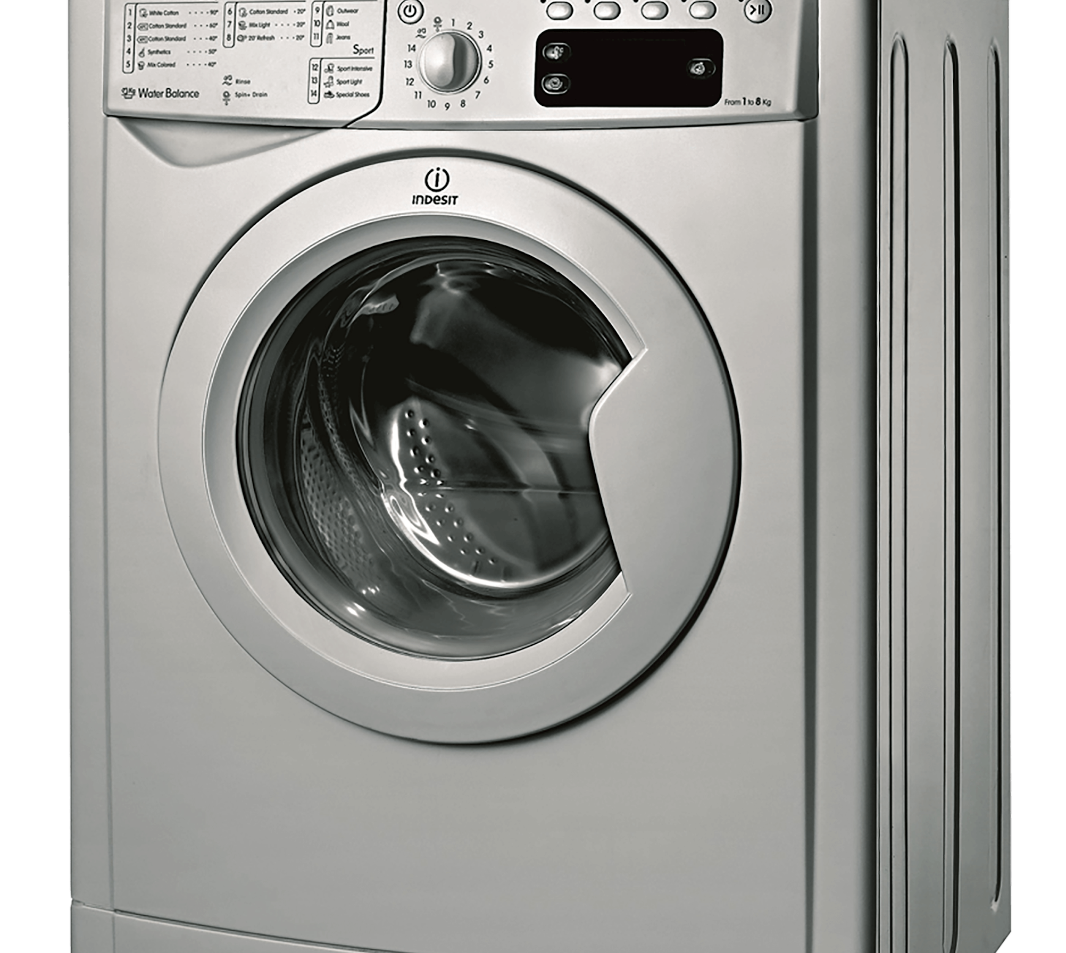
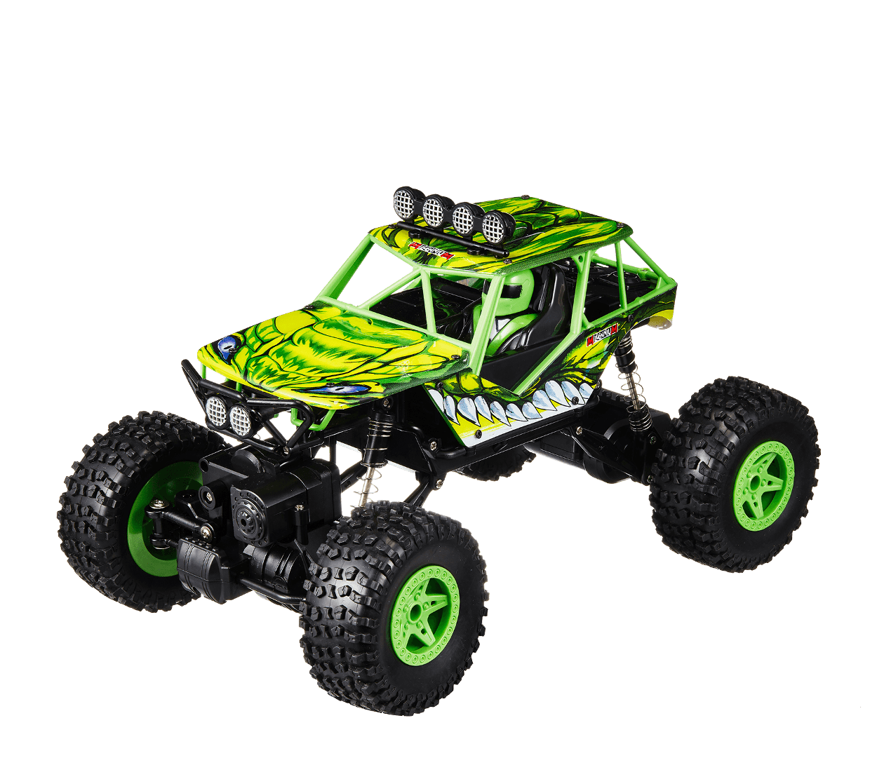
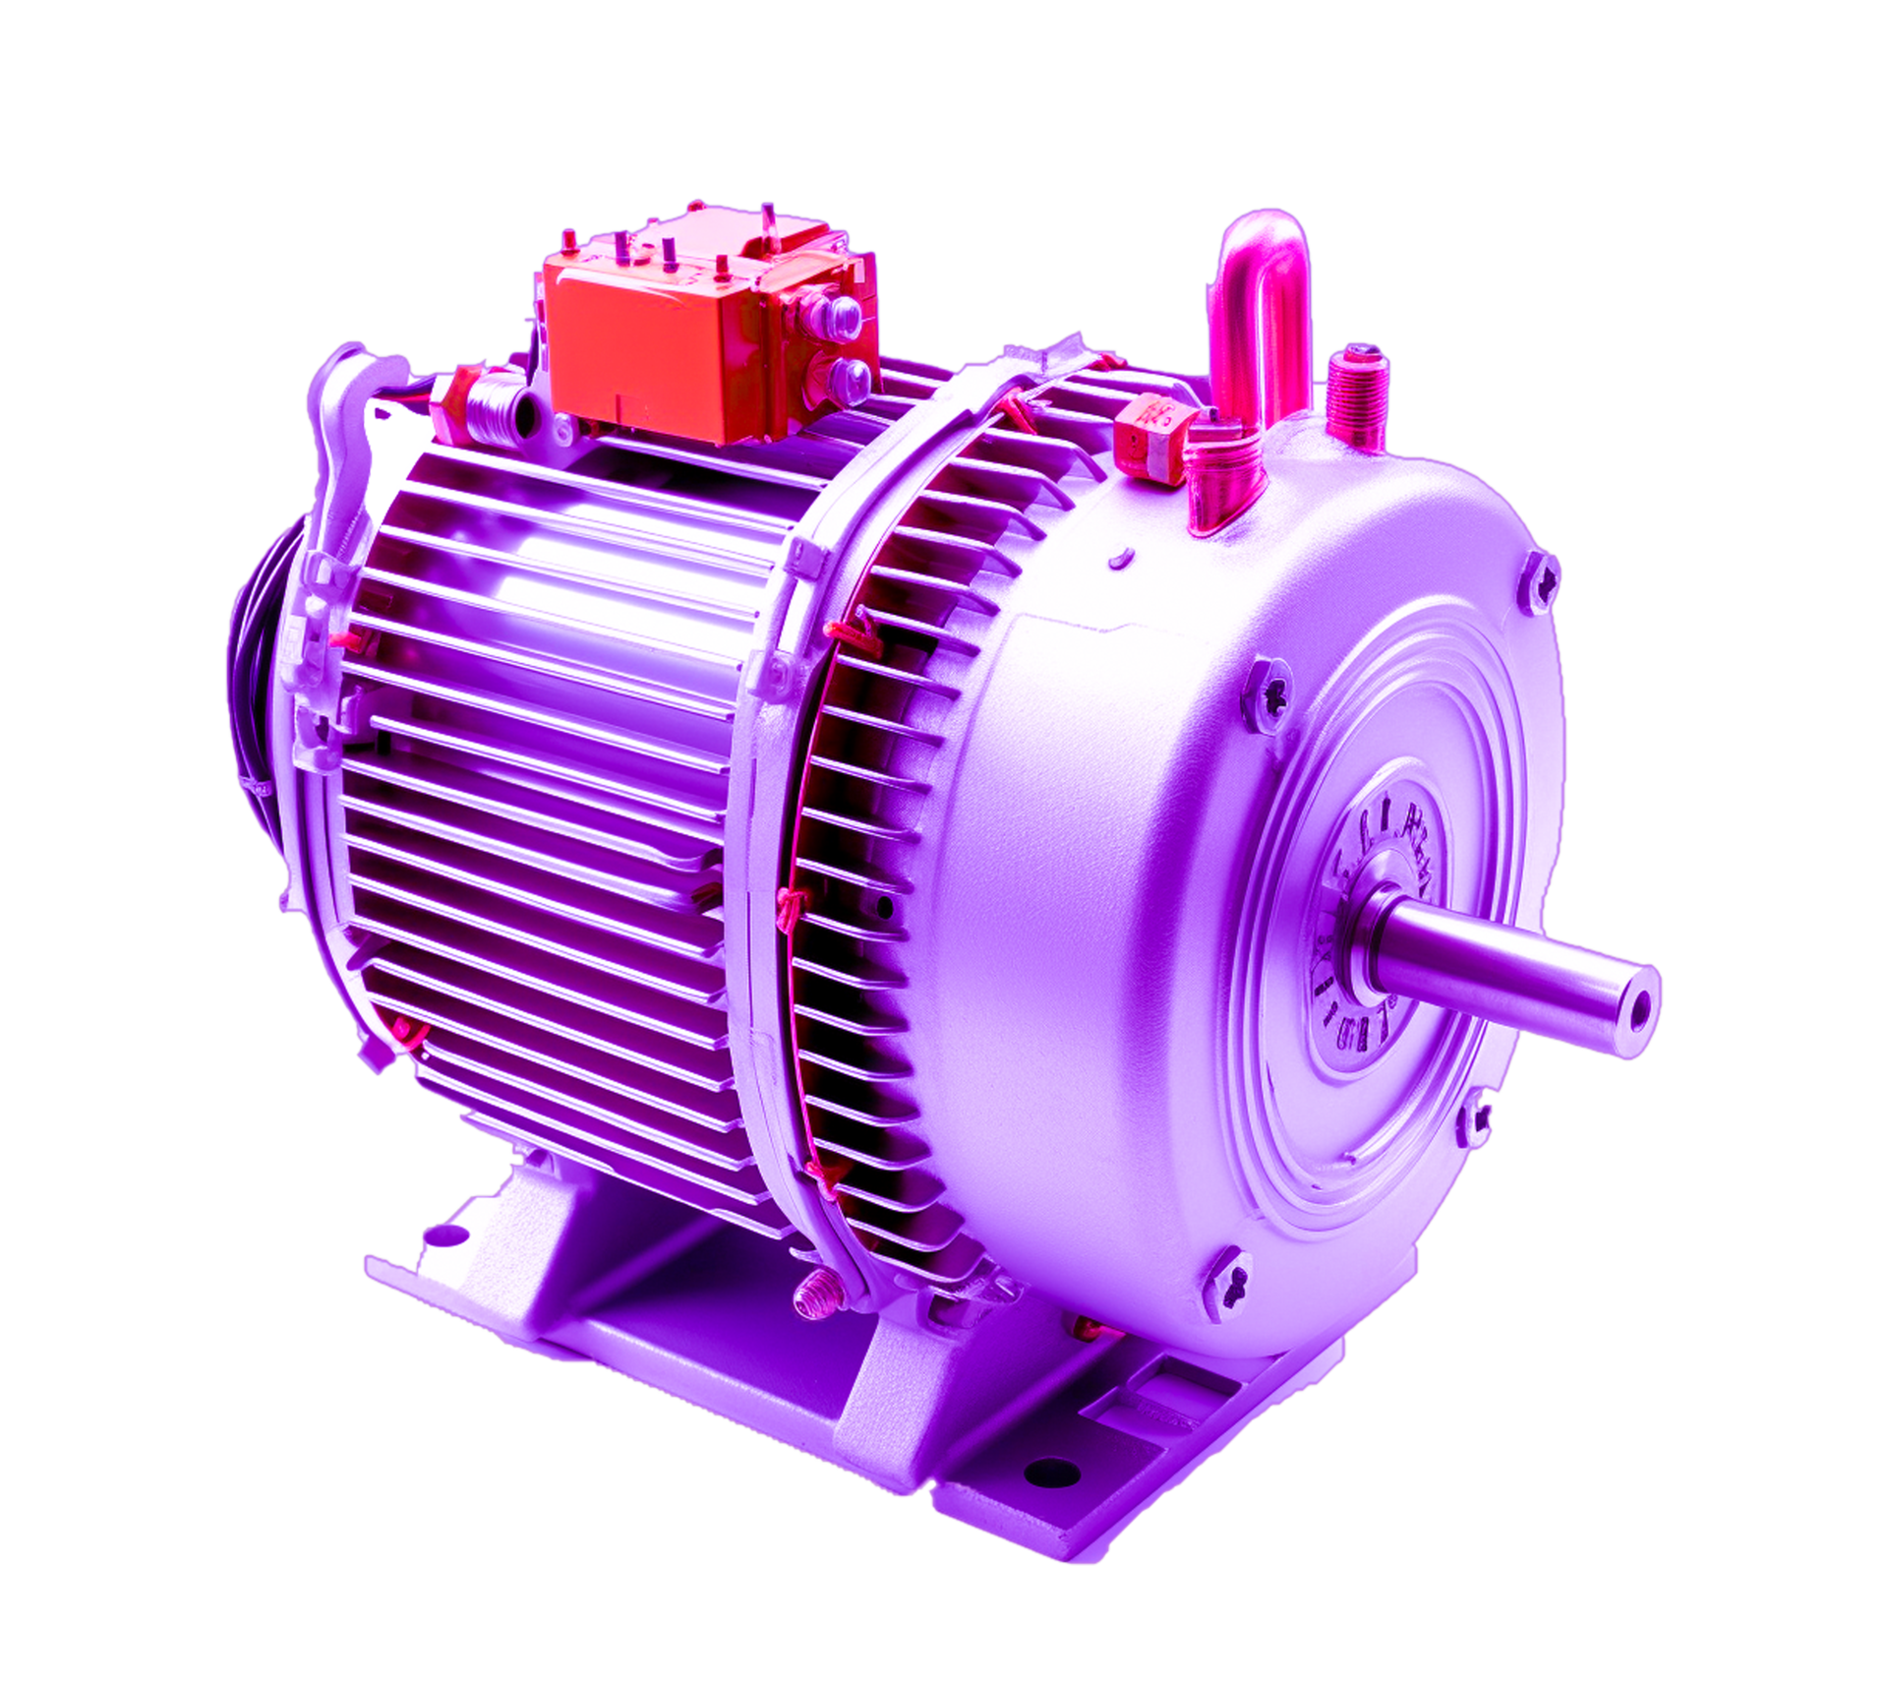
REASON
Electric motors are used in diversified places, from household applications and hobby projects to factories. Hence, an electric motor is usable if the specifications satisfy the need. With this project, we plan to make an axial electric motor with a Do-It-Yourself car kit.

Slide 3
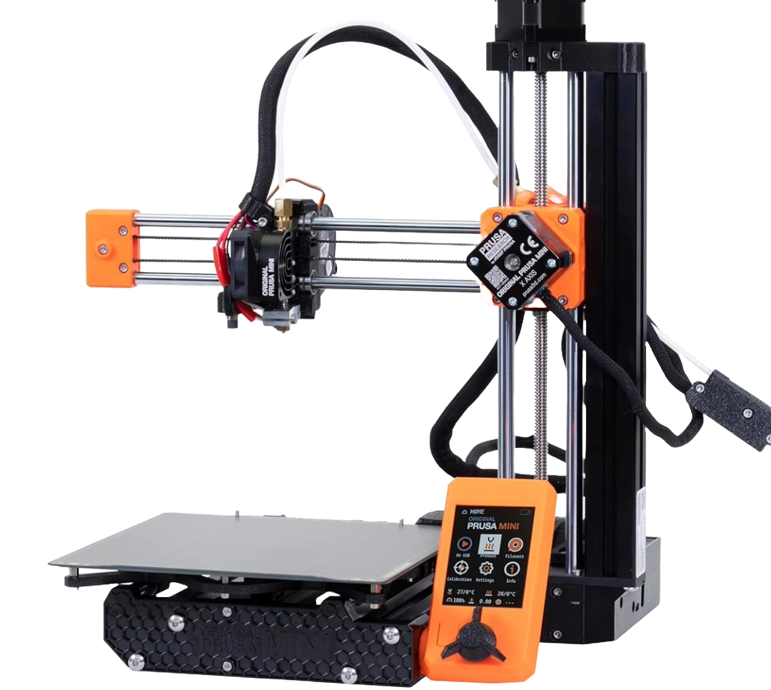
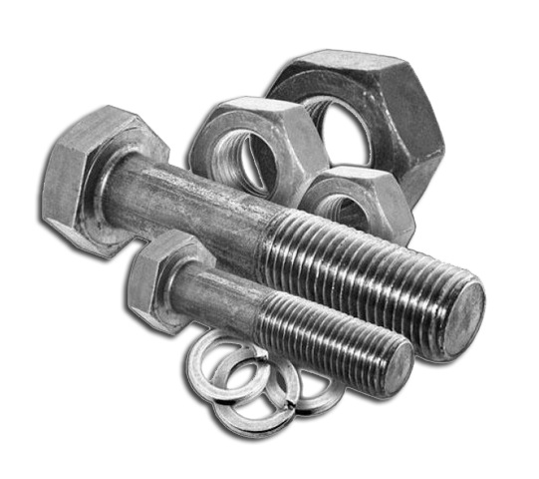
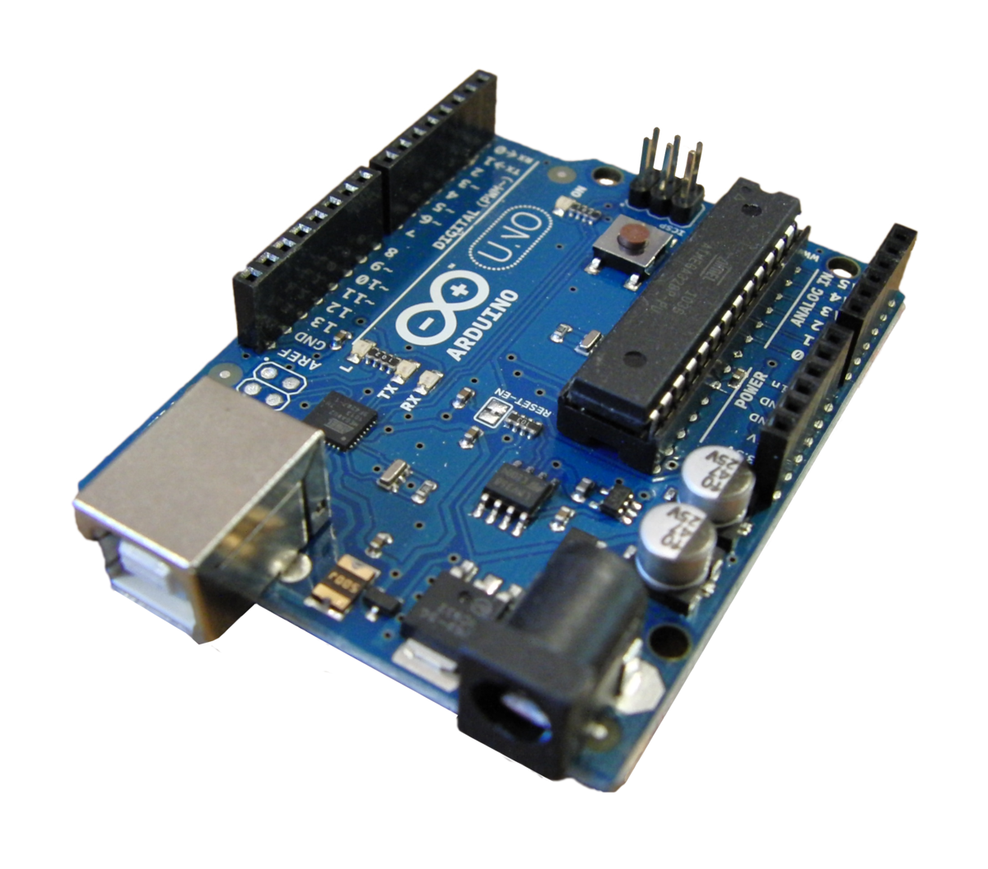
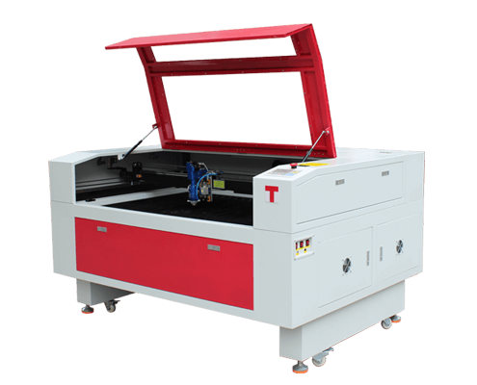
SCOPE/METHOD
The motor and the car kit will be designed in a CAD software, then parts are going to be produced via using a 3d printer and a laser cutter. The product will be controlled by an Arduino equipped with an RF module both on the car and controller with a custom PBC.

Slide 4
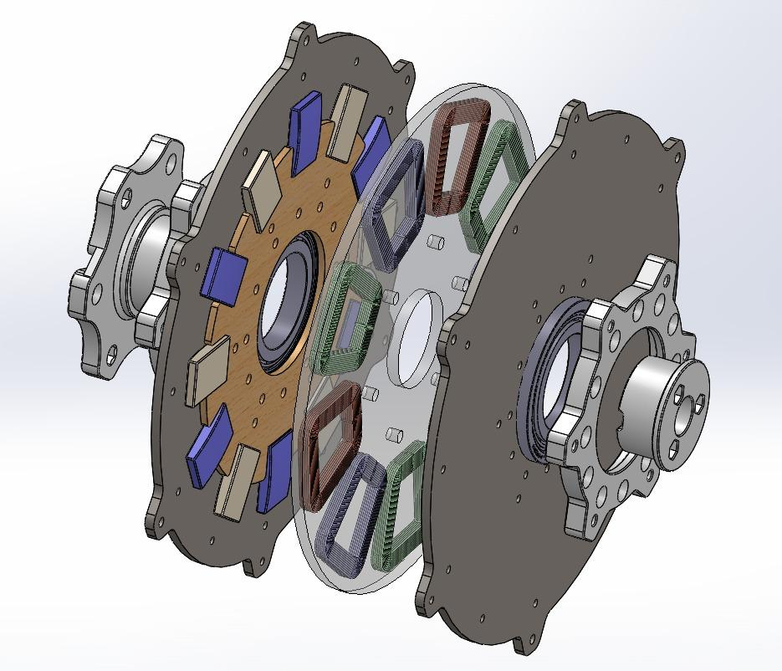
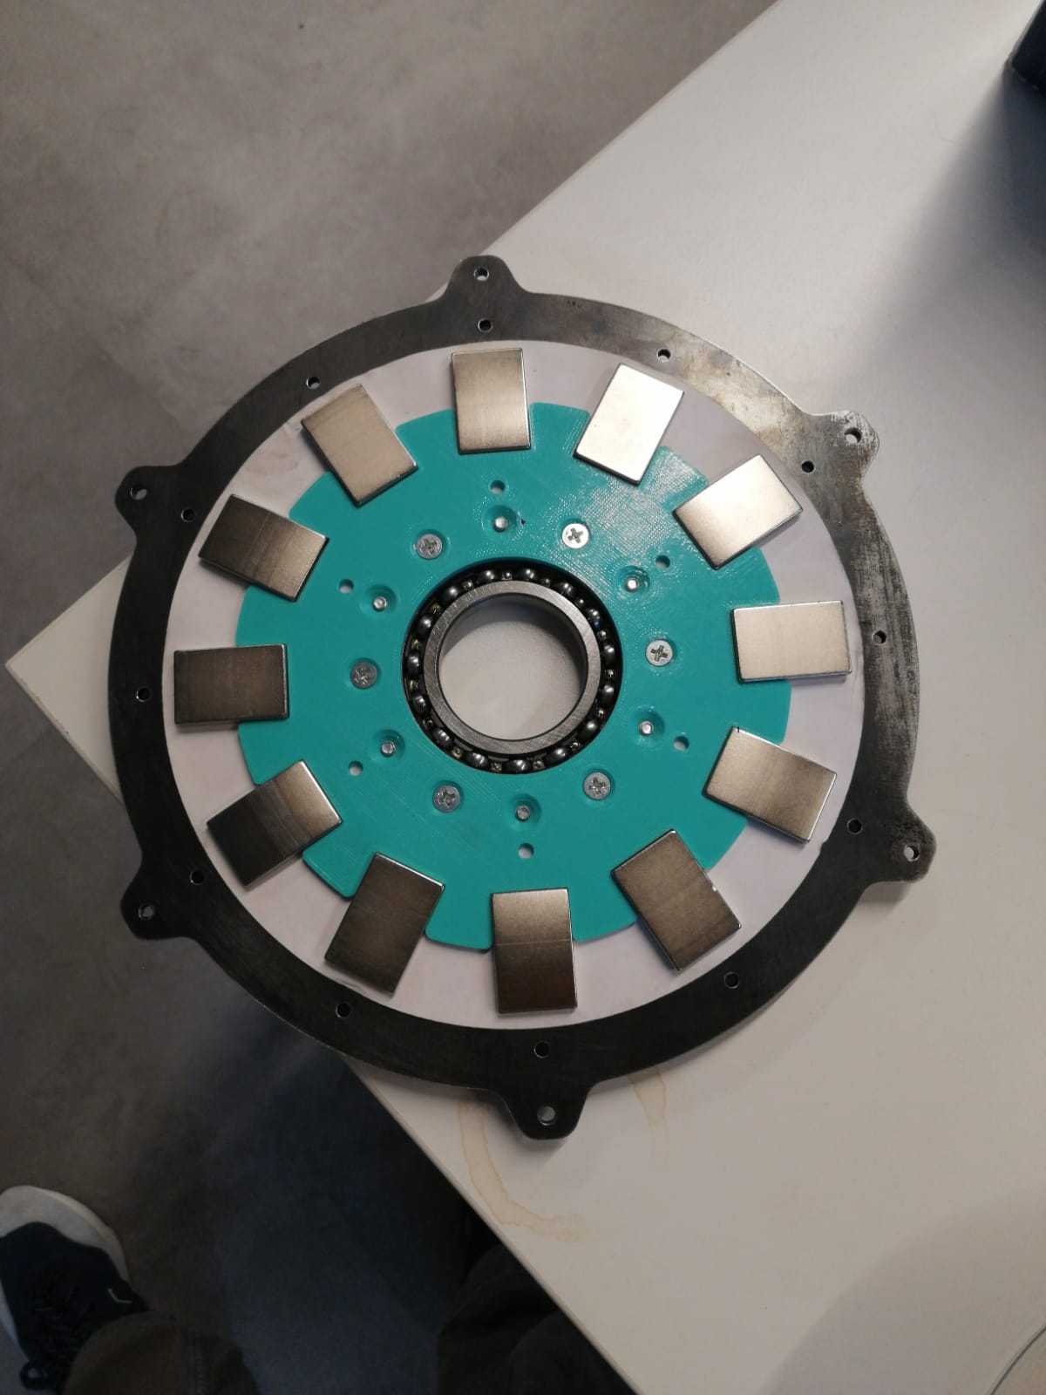
Created 3D model of every component in AutoCAD. Two gray disc is made of steel and other plaques are made of 3D prints.

Slide 5
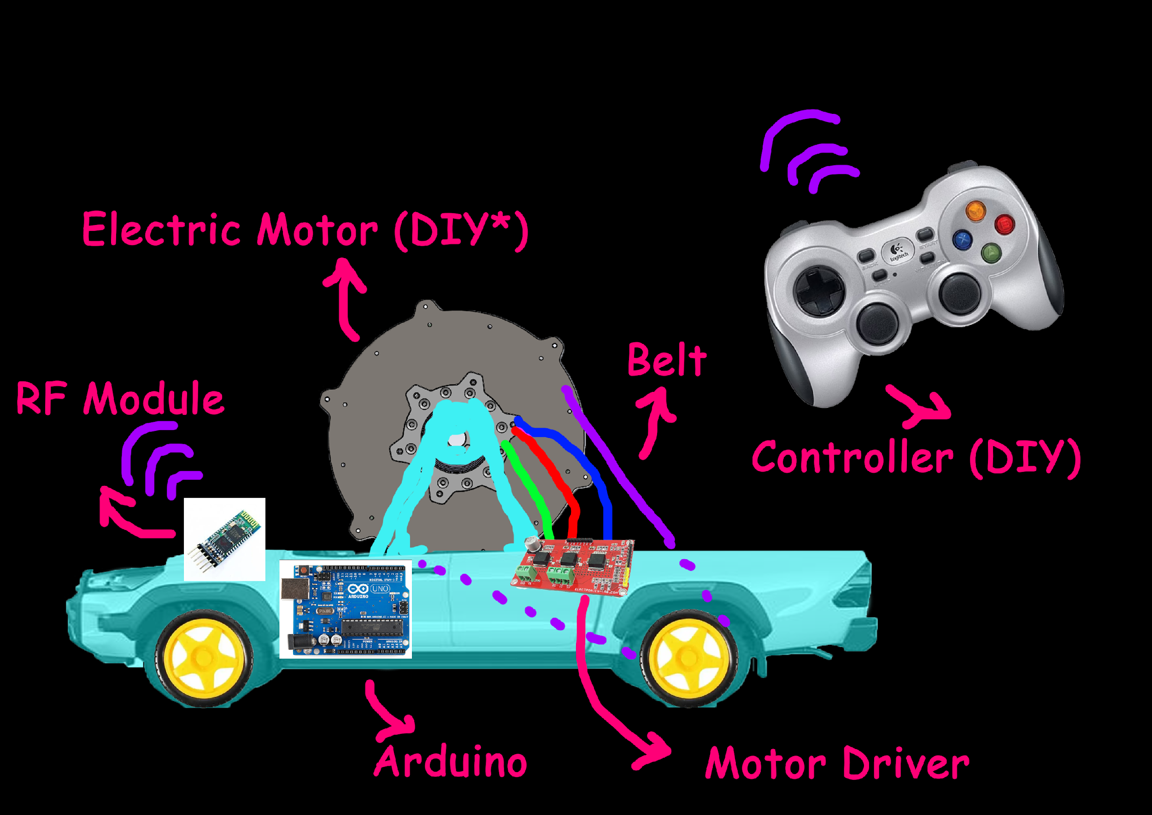
PROJECT OUTPUTS
An electric motor that can be used as a standalone device.
A car kit with integratable hand-made axial motor.
A remote controller to control motor speed and direction of the car.

Slide 6
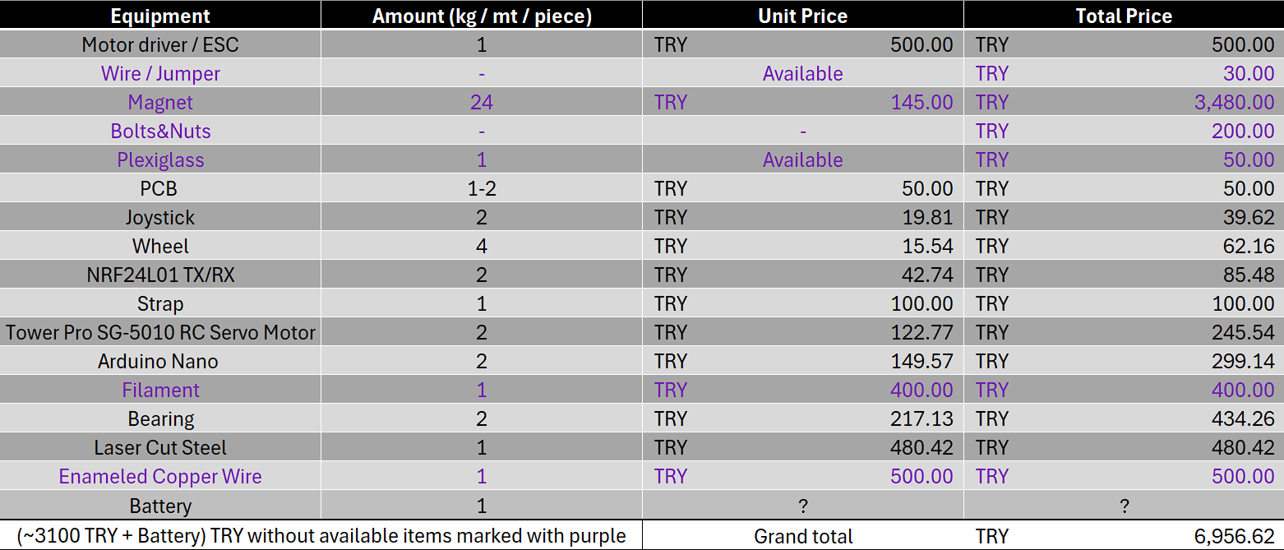
COST ANALYSIS
Complete a cost analysis for this project

Slide 7
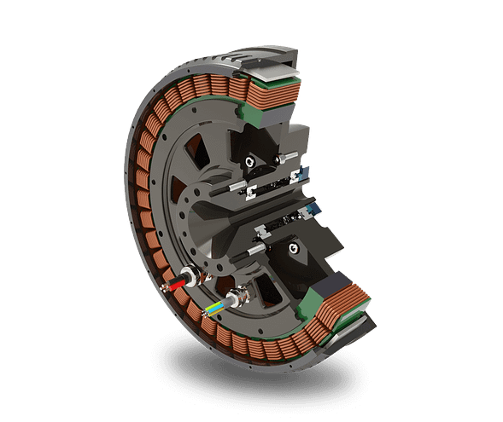
COMMERCIALIZATION
Unlock Creativity through Hands-On Learning!
Our DIY RC car kit encourages hands-on exploration and creativity. With two versions available: Standard and Experienced. It caters to all skill levels you can personalize your RC car, learn through assembly
Experience the joy of DIY where learning meets creativity.

